Slide 1


Built-in Functions
Functions and Wildcards
in MySQL Server
Functions
& Wildcards
SoftUni Team
Technical Trainers
Software University
http://softuni.bg

Slide 2
Table of Content
Functions in MySQL Server
String Functions
Arithmetical Operators and Numeric Functions
Date Functions
Wildcards

Slide 3
Questions
sli.do #JavaDB

Slide 4

Functions in MySQL Server

Slide 5

SQL Functions
String Functions – for manipulating text, both from table values or user input
E.g. concatenate column values
Math Functions – calculations and working with aggregate data
E.g. perform geometry and currency operations
Date and Time Functions
E.g. find length of timespan
Other

Slide 6

String Functions

Slide 7
String Functions
SUBSTRING() – extracts part of a string
SUBSTRING(String, Position)
SUBSTRING(String, Position, Length)
SUBSTRING(String FROM Position FOR Length)

Slide 8
SUBSTRING - Example
Get short summary of article
SELECT `article_id`, `author`, `content`,
SUBSTRING(`content`, 1, 200) AS 'Summary'
FROM `articles`;

Slide 9
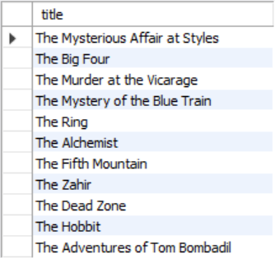
Problem: Find Book Titles
Write a query to find all book titles that start with "The"
Query book_library database

Slide 10
Solution: Find Book Titles
SELECT title FROM books WHERE SUBSTRING(title, 1, 3) = "The";

Slide 11
String Functions (2)
REPLACE – replaces specific string with another
Performs a case-sensitive match
String to replace
REPLACE(String, Pattern, Replacement)
Field from table
Replacement pattern

Slide 12
REPLACE - Example
Censor the word blood from album names
SELECT REPLACE(`title`, 'blood', '*****')
AS 'Title'
FROM `album`;

Slide 13
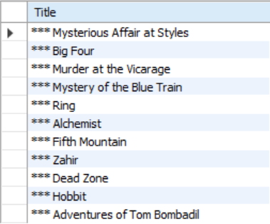
Problem: Replace Titles
Write a query to find all book titles that start with "The" and replace the substring with "***"
Query book_library database

Slide 14
Solution: Replace Titles
SELECT REPLACE(`title`, 'The', '***')
AS 'Title' FROM `books`
WHERE SUBSTRING(title, 1, 3) = 'The';

Slide 15
String Functions (3)
LTRIM & RTRIM – remove spaces from either side of string
CHAR_LENGTH – count number of characters
LENGHT – get number of used bytes (double for Unicode)
LTRIM(String)
RTRIM(String)
CHAR_LENGTH(String)
LENGTH(String)

Slide 16
String Functions (4)
LEFT & RIGHT – get characters from beginning or end of string
Example: name shorthand (first 3 letters)
LEFT(String, Count)
RIGHT(String, Count)
SELECT `id`, `start`,
LEFT(`name`, 3) AS 'Shorthand'
FROM `games`;

Slide 17
String Functions (6)
LOWER & UPPER – change letter casing
REVERSE – reverse order of all characters in string
REPEAT – repeat string
LOWER(String)
UPPER(String)
REVERSE(String)
REPEAT(String, Count)

Slide 18
String Functions (7)
LOCATE – locate specific pattern (substring) in string
INSERT – insert substring at specific position
If omitted, begins at 1
LOCATE(Pattern, String,[Position])
INSERT(String, Position, Length, Substring)
Number of characters
to delete

Slide 19

Arithmetical Operators and Numeric Functions

Slide 20
Arithmetical Operators
Supported common arithmetic operators
Name | Description
DIV | Integer division
/ | Division operator
- | Minus Operator
%, MOD | Modulo operator
+ | Addition operator
* | Multiplication operator
- (arg) | Change sign of argument

Slide 21
Numeric Functions
Used primarily for numeric manipulation and/or mathematical calculations
PI – get the value of Pi (15 –digit precision)
ABS – absolute value
SELECT PI() +0.000000000000000
ABS(Value)

Slide 22
Numeric Functions (2)
SQRT – square root
POW – raise value to desired exponent
SQRT(Value)
POW(Value, Exponent)

Slide 23
Math Functions (3)
CONV – Converts numbers between different number bases
ROUND – obtain desired precision
FLOOR & CEILING – return the nearest integer
CONV(Value,from_base,to_base)
Can be negative
ROUND(Value, Precision)
FLOOR(Value)
CEILING(Value)

Slide 24
Math Functions (4)
SIGN – returns +1, -1 or 0, depending on value sign
RAND – get a random value in range [0,1)
If Seed is not specified, one is assigned at random
SIGN(Value)
RAND()
RAND(Seed)

Slide 25

Date Functions

Slide 26
Date Functions
EXTRACT – extract a segment from a date as an integer
TIMESTAMPDIFF – find difference between two dates
Part can be any part and format of date or time
EXTRACT(Part FROM Date)
TIMESTAMPDIFF(Part, FirstDate, SecondDate)
year, %Y, %y
YEAR(Date)
month, %M, %m
MONTH(Date)
day, %w, %D
DAY(Date)

Slide 27
Date Functions - Example
Show employee experience
SELECT `employee_id`, `first_name`, `last_name`,
TIMESTAMPDIFF(year, `hire_date`, '2017-05-31')
AS 'Years In Service'
FROM `employees`;

Slide 28
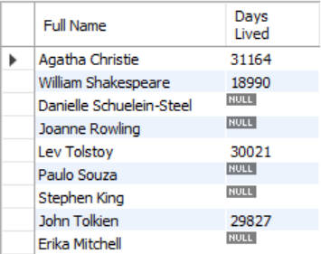
Problem: Days Lived
Write a query to calculate how many days have authors lived
Use TIMESTAMPDIFF
Query book_library database

Slide 29
Solution: Days Lived
SELECT concat(first_name, ' ', last_name) AS 'Full Name',
TIMESTAMPDIFF(DAY, born, died) AS 'Days Lived'
FROM authors;

Slide 30
Date Functions (3)
DATE_FORMAT – formats the date value according to the format
NOW – obtain current date and time
SELECT DATE_FORMAT('2017/05/31', '%Y %b %D') AS 'Date';
SELECT NOW();

Slide 31

Wildcards
Selecting results by partial match

Slide 32
Wildcards
Used to substitute any other character(s) in a string
'%' - represents zero, one, or multiple characters
'_' - represents a single character
Can be used in combinations
Used with LIKE operator in a WHERE clause
Similar to Regular Expressions

Slide 33
Wildcards - Examples
Find any values that start with "a"
Find any values that have "r" in second position
Finds any values that starts with "a" and ends with "o"
WHERE CustomerName LIKE 'a%';
WHERE CustomerName LIKE '_r%';
WHERE ContactName LIKE 'a%o';

Slide 34
Wildcard Characters
Supported characters also include:
\ – specify prefix to treat special characters as normal
[charlist] – specifying which characters to look for
[!charlist] – excluding characters
SELECT * FROM `customers`
WHERE `city` LIKE '[a-c]%';
"a", "b", or "c"

Slide 35
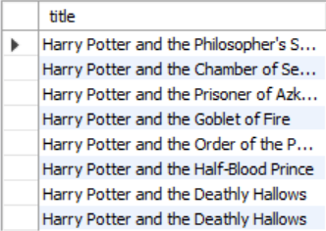
Problem: Harry Potter Books
Write a query to retrieve information about the titles of all Harry Potter books
Use Wildcards
Query book_library database

Slide 36
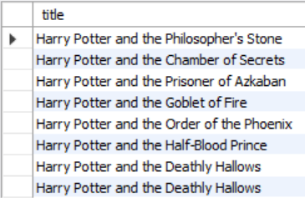
Solution: Harry Potter Books
SELECT title FROM books
WHERE title LIKE 'Harry Potter%';

Slide 37
Using Regular Expression
REGEXP - pattern matching using regular expressions
SELECT `employee_id`, `first_name`, `last_name`
FROM `employees`
WHERE `first_name` REGEXP '^\[^K\]{3}\$';
Regular expression

Slide 38

Summary
…
…
…
MySQL Server provides various built-in
functions
Numerical functions
String functions
Using Wildcards, we can obtain results by
partial string matches
Regular expressions

Slide 39
https://softuni.bg/trainings/courses

Slide 40













SoftUni Diamond Partners

Slide 41





SoftUni Organizational Partners

Slide 42




Trainings @ Software University (SoftUni)
Software University – High-Quality Education and Employment Opportunities
softuni.bg
Software University Foundation
http://softuni.foundation/
Software University @ Facebook
facebook.com/SoftwareUniversity
Software University Forums
forum.softuni.bg

Slide 43

License
This course (slides, examples, demos, videos, homework, etc.) is licensed under the "Creative Commons Attribution-NonCommercial-ShareAlike 4.0 International" license

